Slide 1
“Cities Start to Question an American Ideal: A House With a Yard on Every Lot”
Byron Huang Sep 2024
https://www.nytimes.com/interactive/2019/06/18/upshot/cities-across-america-question-single-family-zoning.html

Slide 2
Main insights

Slide 3
1. Prevalence of single-family zoning in the US + its legacy on communities
Main Insights
At present, 75% of residential land in the US are zoned exclusively for detached single-family homes.
Segregation by housing type is intertwined with segregation by income. Reversing single-family zoning is thus motivated by social justice considerations such as poverty alleviation and improved economic prospects of marginalised social groups.

Slide 4
2. Reversing the trend of single-family zoning is far from being a simple process
Main Insights
Removing single-family zoning requires significant political will on the part of local elected leaders, as demonstrated by the 12–1 vote in the Minneapolis City Council to end single-family zoning despite having 20,000 residents expressing their opposition to the plans.
The politics of zoning is complicated by competing interests—the desire for density (for jobs accessibility and agglomeration effects) and the desire for sprawl (for increased living spaces)—which are seldom reconcilable.

Slide 5
3. The alternatives to single-family zoning are not new
Main Insights
Allowing for different housing densities within neighbourhoods is not a new concept—in fact, there has long been a mixture of housing types in many cities in the US before single-family zoning gained popularity among planners.

Slide 6
Visuals

Slide 7
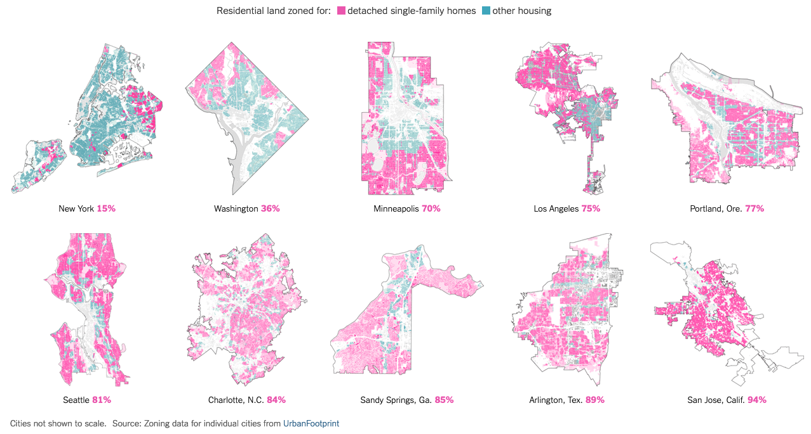
Small-multiples map in the introduction section
Shows the extent of single-family zoning in different cities

Slide 8
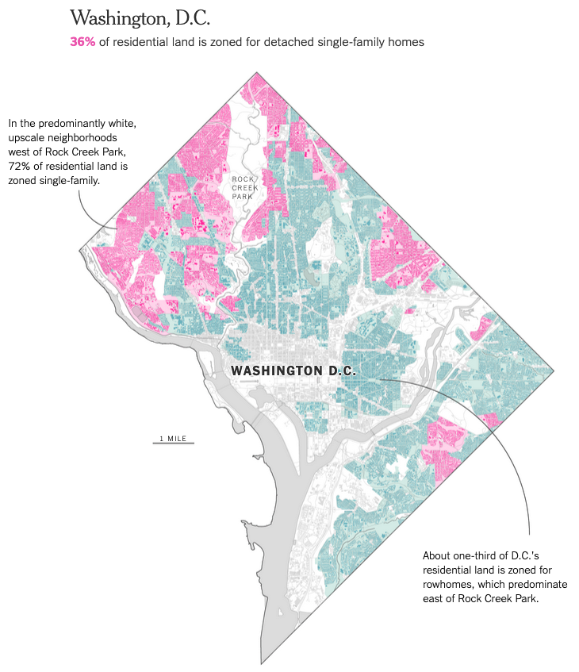
Exhibits of individual cities
Illustrates the spatial patterns of single-family zoning within cities

Slide 9
Context & background

Slide 10
Describing the practice of single-family zoning
Context & Background
The authors first introduce the practice of single-family zoning in the US—how it has been used by local communities as an instrument to preserve the low-density characteristic of their neighbourhoods.
This sets up the context for the recent trend of state governments (such as those in Oregon and California) legislating the end of single-family zoning and politicians (such as Elizabeth Warren) voicing their opposition to the practice.

Slide 11
Arguments for & against
Context & Background
The authors then set out common justifications for preserving / abolishing single-family zoning.
Critics of single-family zoning argue that it exacerbates housing unaffordability in cities, reinforce racial inequality and are environmentally unsustainable.
Proponents of single-family zoning—include current homeowners who benefit from its effects—argue that relaxing such planning policies would cause their property values and overall quality of life to decrease.

Slide 12
Transitions

Slide 13
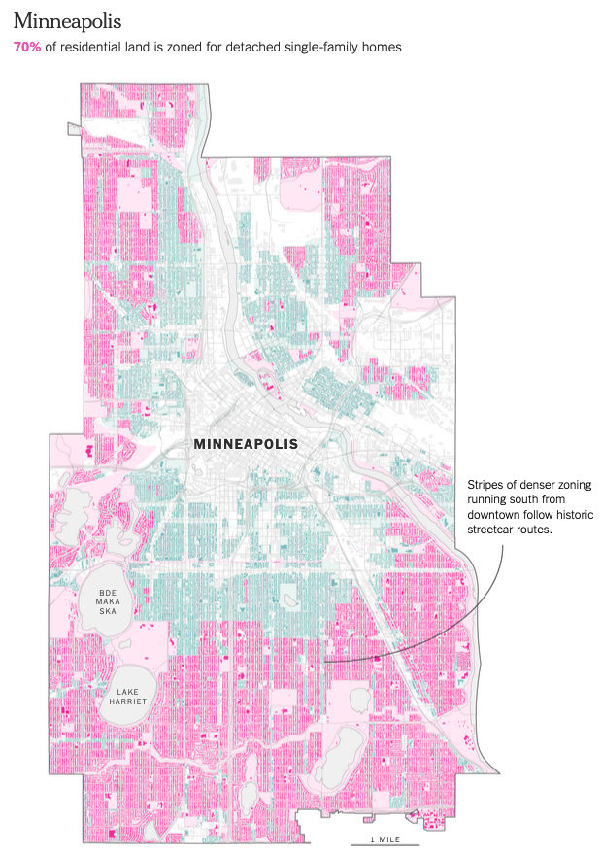
From text to visuals—reinforcing the point
Transitions
Many visuals add effect to the preceding text.
For instance, following the discussion on the legacy of a century of single-family zoning, the authors insert a map (pictured on the left) showing the current extent of single-family zoning in the city of Minneapolis, and then proceed to discuss how the city’s leaders aim to reverse this course by upzoning all of its single-family neighbourhoods at once.

Slide 14
Transitions as contrasts
Transitions
Setting up contrasting case studies is an effective tool used by the authors to demonstrate the spatial impact of single-family zoning (or the lack thereof).
For instance, the transition from the case study of New York (where there is limited single-family zoning in practice) to the case study of Charlotte (where single-family zoning dominates the city, despite apparent social problems arising from it) is effective in communicating the legacy of decades of the conventional wisdom of adopting single-family zoning in developments.

Slide 15
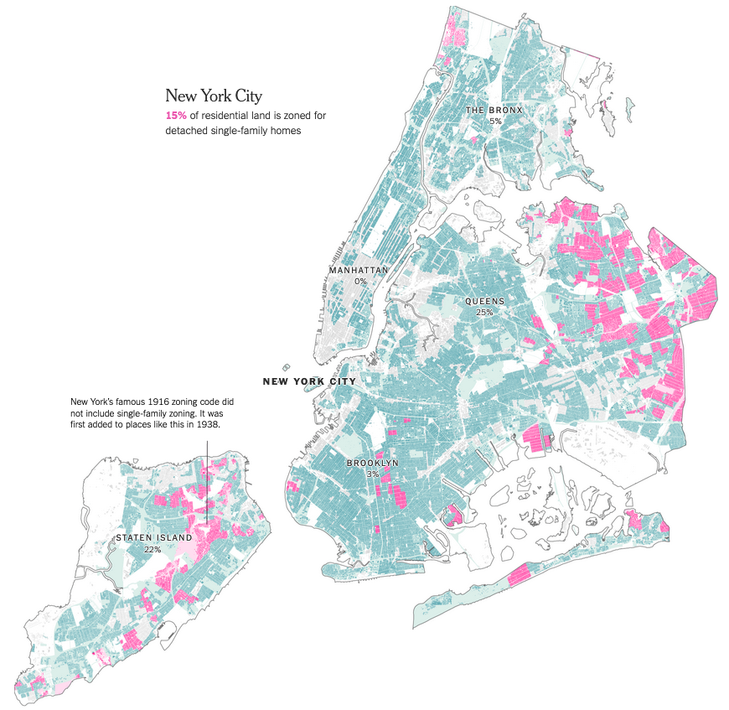
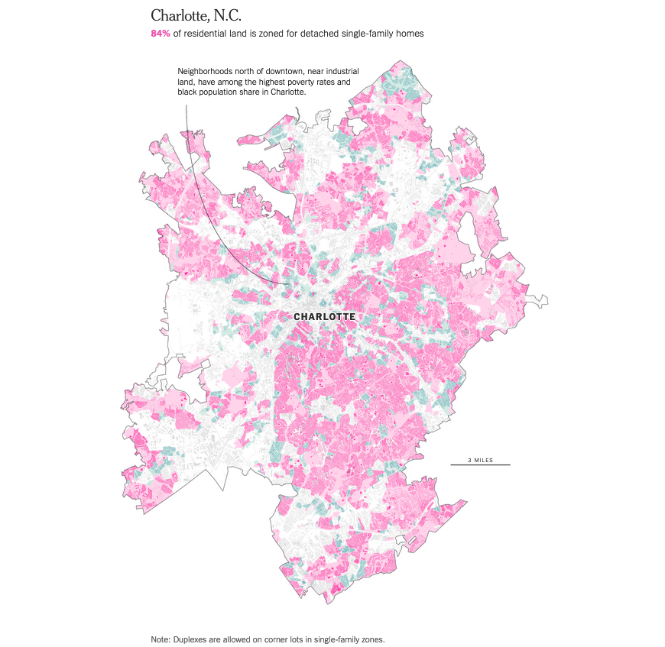
Transitions as contrasts
Transitions
Contrast between New York and Charlotte:

Slide 16
Transitions to bring out nuances in arguments
Transitions
Transitions are also effectively used to bring out nuances in the evaluation of policies regarding single-family zoning.
For instance, after introducing the ban on single-family zoning by Minneapolis, the authors then present the argument by opponents who caution that relaxing zoning policies is fertile ground for developers to reap significant profits, while not necessarily delivering social goals such as increased supply of affordable housing.

Slide 17
Conclusions

Slide 18
Key takeaways
Conclusions
Single-family zoning still remains prevalent in contemporary US cities.
There has been increasing momentum to abolish single-family zoning in some cities and states, although these tend to be accompanied by vocal opposition to plans.
While single-family zoning is associated with segregation by income and race, ending single-family zoning does not automatically bring these social problems to an end, particularly as commercial real estate interests dominate the sphere of urban redevelopment that such bans bring about.

Slide 19
Reference
Reference
Original article from New York Times:
Cities Start to Question an American Ideal: A House With a Yard on Every Lot (Emily Badger and Quoctrung Bui)
Jun 18, 2019
https://www.nytimes.com/interactive/2019/06/18/upshot/cities-across-america-question-single-family-zoning.html

